Slide 1
Introduction To Deep Learning
By: Akhil Suri

Slide 2
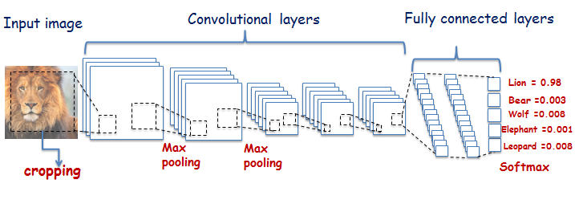
General Deep Learning Usage
Source: https://www.rug.nl/research/bernoulli/groups/autonomus-perceptive-systems/research_and_projects/phd-project_-comparative-study-between-deep-learning-and-bag-of-visual-words-for-animal-recognit?lang=en

Slide 3
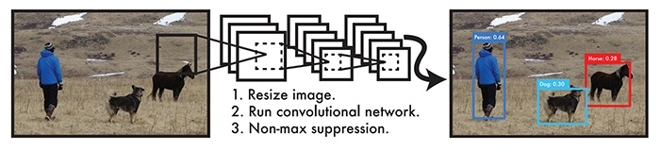
Common Deep Learning Models
Source: https://tryolabs.com/blog/2017/08/30/object-detection-an-overview-in-the-age-of-deep-learning/

Slide 4
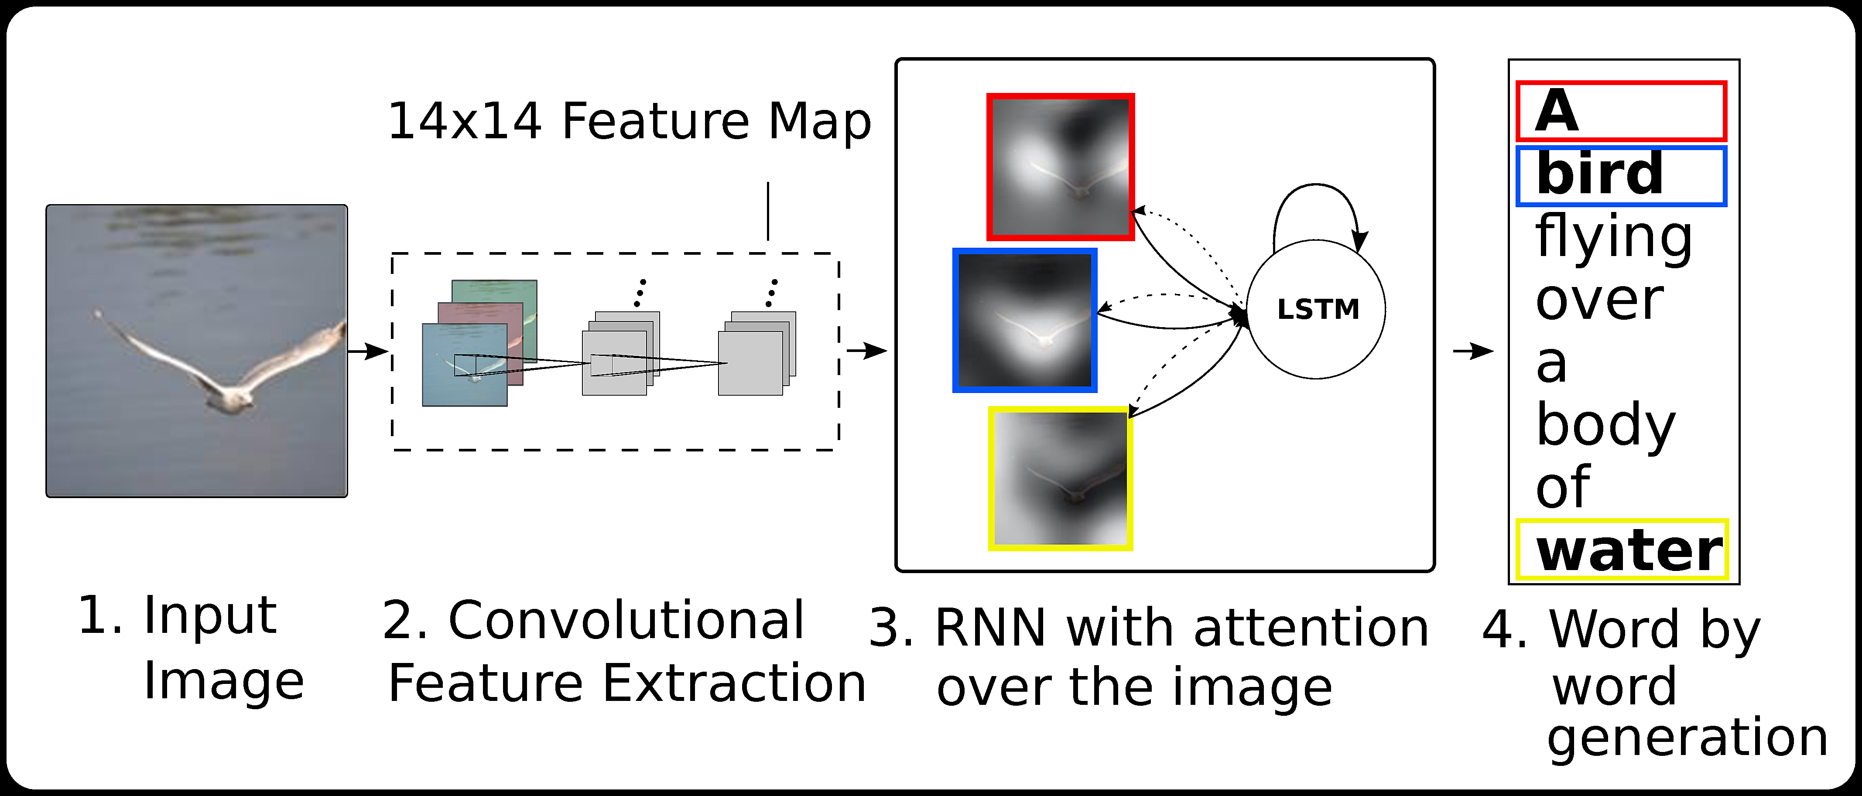
Common Deep Learning Models
Source: https://github.com/handong1587/handong1587.github.io/blob/master/_posts/deep_learning/ 2015-10-09-captioning.md

Slide 5
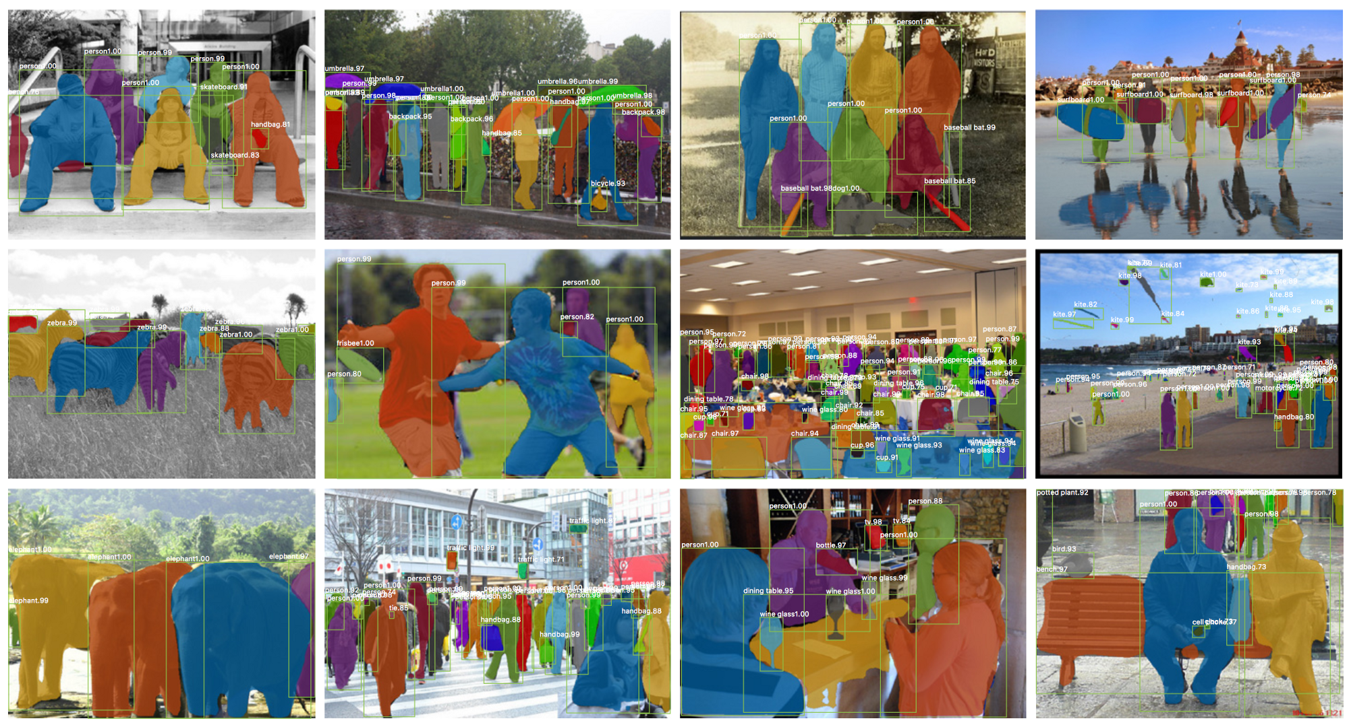
Common Deep Learning Models
Source: http://www.thothchildren.com/chapter/59b94f4a75704408bd430150

Slide 6
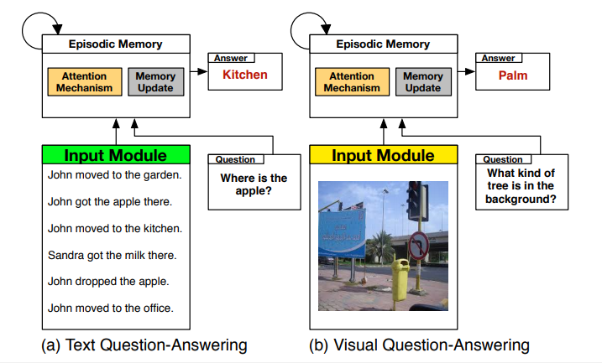
Common Deep Learning Models
Source: https://arxiv.org/pdf/1603.01417.pdf

Slide 7
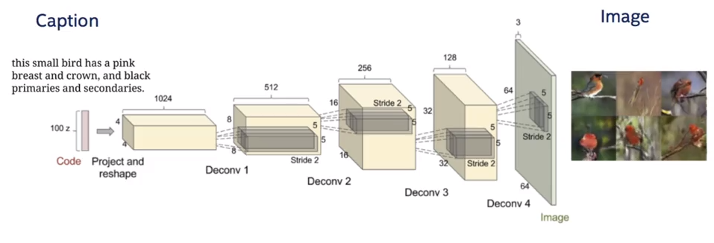
Common Deep Learning Models
Source: https://arxiv.org/pdf/1701.00160.pdf

Slide 8
Artificial Intelligence, Machine Learning and Deep Learning
Artificial Intelligence A program that can sense, reason, act and adapt
Machine Learning Algorithm whose performance improve as they are exposed to more data over time
Deep Learning Subset of machine learning in which multilayer neural networks learns from vast amount of data

Slide 9
Very Brief History Of Deep Learning
1960s: Neural Networks used of binary classification
1970s: Neural Networks popularity dries after not delivering on the hype
1980s: Backpropagation is used to train the deep networks
1990s: Neural Networks take the back seat to support vector machines due to the nice theoretical properties and guarantee bounds
2010s: Access to large dataset and more computation allowed deep networks to return and have state-of-the-art results in the speech, vision and natural language processing.

Slide 10
Why Now?
Larger Datasets
Image 1000kb/ picture
Audio: 5000km/ song
Better Hardware
Transistors density doubles every 18months.
Cost per GB in 1995: $1000.00
Smarter Algorithms
Advances in algorithm innovation, including neural network, leading to better accuracy in training models
Video: 5,000,000/movie
Cost per GB in 2017: $0.02

Slide 11
Types of Machine Learning Algorithms

